Slide 1
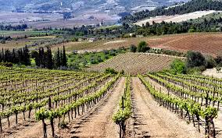
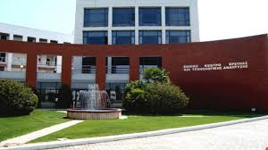
Conservation and sustainable capitalization of biodiversity in the genomics era
Madesis Panagiotis
Institute of Applied Biosciences
Ass. Prof. University of Thessaly

Slide 2
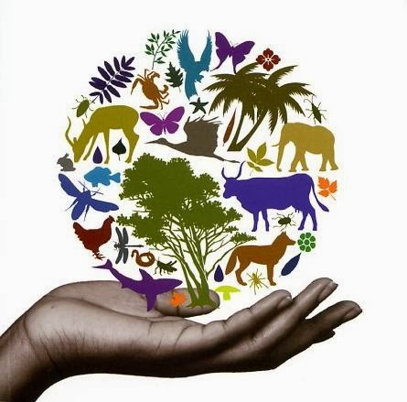
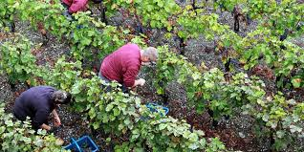
Biodiversity
The diversity between living organisms or different species in an area
Bioprospecting is the process of discovery and commercialization of new products based on bio-diversity

Slide 3
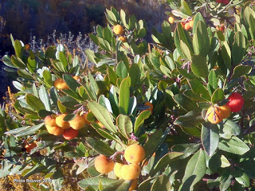
Biodiversity in Greece
6622 plant taxa (species and subspecies)
~ 1000 endemic taxa
Identification authentication and conservation of Greek
biodiversity: a major objective!

Slide 4
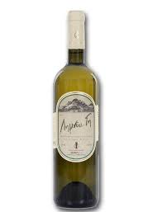
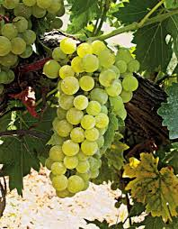
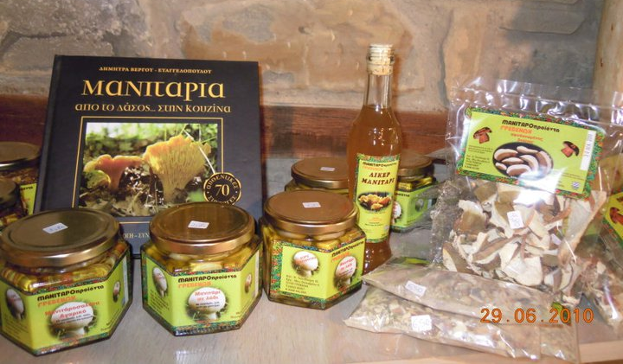
Biodiversity
Important for the local community: they are of great economic importance as they are adapted to local conditions
Maintain microclimate and soil Source of valuable genes
Genetic valuation of biodiversity of great importance for its conservation decisions

Slide 5
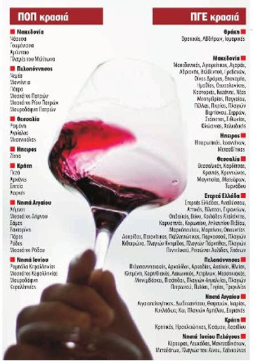



Biodiversity EU categories of quality agricultural products and foodstuffs
Protected Designation of Origin (PDO),
Protected Geographical Indication (PGI),
Traditional Speciality Guaranteed (TSG)
Mountain products
Island products

Slide 6
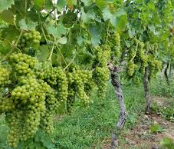
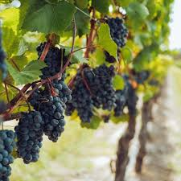
Plant Genetic Resources and landraces
Important for local society: adapted to the local conditions, important nutritional and economical value
Important for breeding : source of invaluable genes for the development of new varieties
Genetic erosion: more than 90% of wheat and vegetable varieties have been lost in the last 50 years

Slide 7
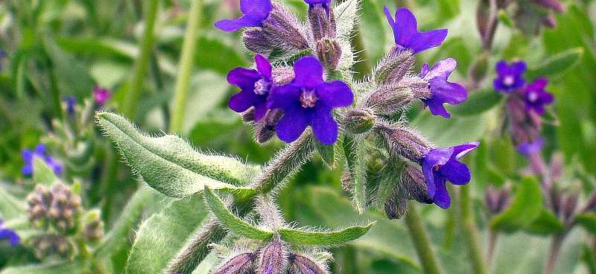
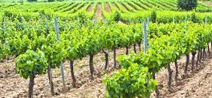
Need for conservation at three levels
Ecosystem diversity
Species diversity
Genetic diversity

Slide 8
Genetic diversity
The economic value of biodiversity is usually correlated with the benefit it offers to humans However, this physical capital is an important factor in the economic value of biodiversity
Total economic value
ecosystem
Benefits
society

Slide 9
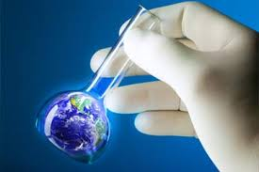
Genetics & Biodiversity
Genetics: a crucial role of biodiversity is its possible future value as a source of valuable genes or constituents
The genetic composition of a population, its age, the likelihood of survival and reproduction indicate its condition
Genetic extinction factor (genetic homicide) should be determined

Slide 10
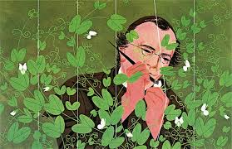
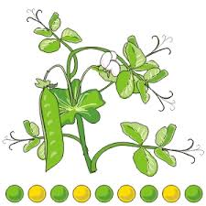
Genomics
From Mendel to Genomics

Slide 11

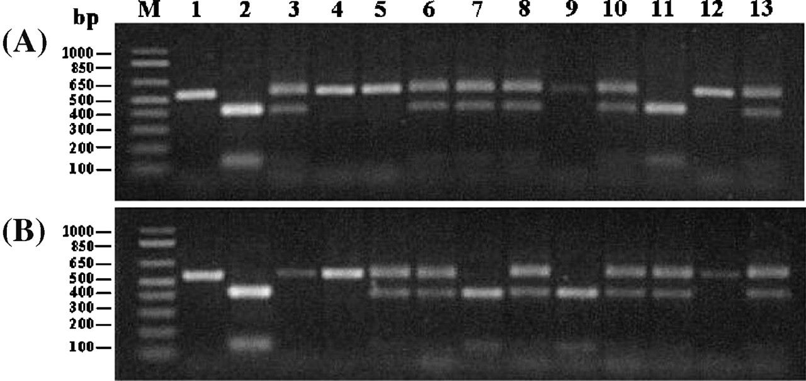
Molecular Genetics
Selection of genetic material via molecular markers use

Slide 12
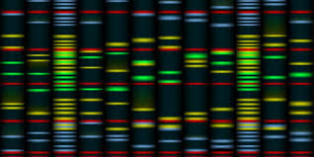
Genomics
From Mendel to Genomics

Slide 13
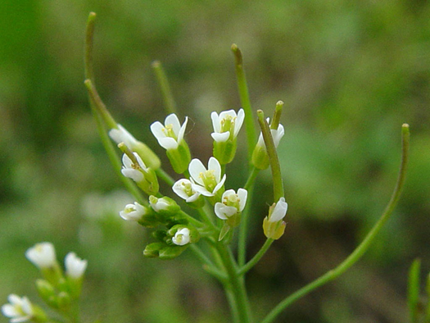
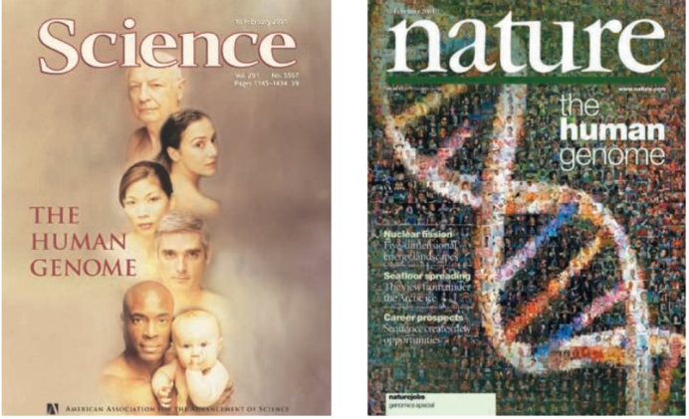
Genomics The next Green Revolution ?
Bacteriophage fX174, was the first genome to be sequenced, a viral genome with only 5,368 base pairs (bp).
In 2000 the first plant genome was
announced Arabidopsis thaliana
(115.4 megabases of the 125-megabase
genome, 25,498 genes found
In 2007 the first Human genome is announced 14.8 billion bp, 26,588 genes

Slide 14
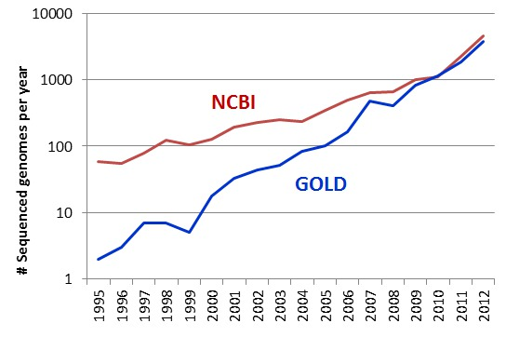
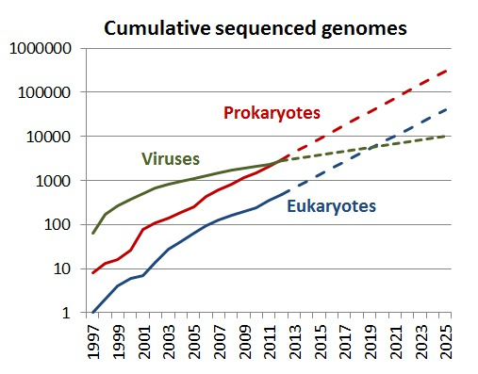
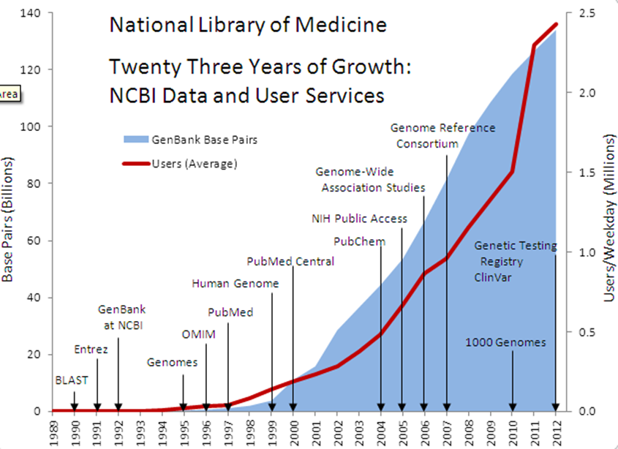
Sequenced Genomes

Slide 15
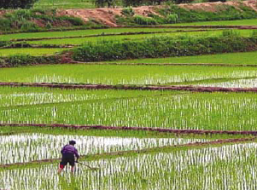
Sequencing of crop-plant genomes
Importance as crop
Largest food source for poor
Feeds half of world’s population (3 billion)
Demand likely to increase dramatically
80% of daily calories in Asia come from rice
In Asia alone, demand will increase by at least 35%.
1000 varieties have been sequenced
Notes:
Even before the Arabidopsis genome was completed, attention turned to sequencing the genomes of other plants. Among crop plants, rice was at the top of the list for full-genome sequencing. In addition to its small genome and the other genomics attributes described on the next slide, it was an attractive target because of its importance as a crop plant. Rice is the source of basic nutrition for approximately 3 billion people, or roughly half of the world’s present population. Many of these people are among the poorest on Earth. In Asia, intake of rice can provide up to 80% of a person’s daily calories. Moreover, the demand for rice and other cereals is likely to increase dramatically in the near future. Predictions are that in Asia alone, demand will increase by at least 35%. With currently available rice strains, this increase represents a figure close to the maximum yield that could be achieved under ideal conditions. The hope is that genomics approaches will provide new ways to increase productivity from rice before demand outstrips the supply.

Slide 16
Plant Genomes – Total Size
Human Cotton Sugarcane
3,300Mbp 2,500Mbp 930Mbp
x2 x4 x8-12
Wheat
17,00
x6

Slide 17
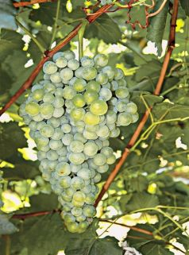
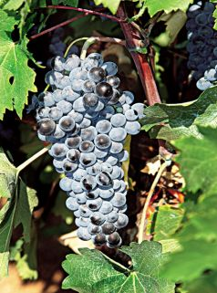
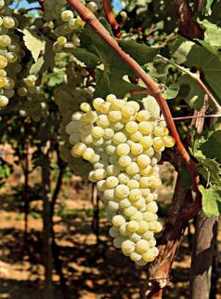
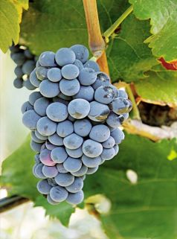
Genotyping and Phenotyping of Vitis vinifera
450 samples, ~300 varieties
SSR analysis, RNA-Sequencing of elite cultivars
Partner of the EU Vitis Database
Aidani
Agiorgitiko
Vidiano
Vertzami

Slide 18
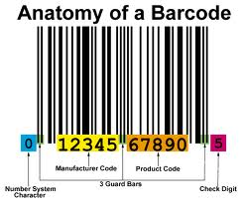
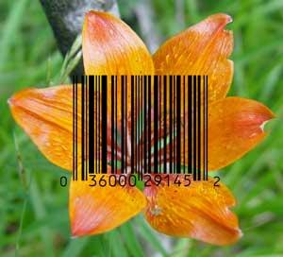
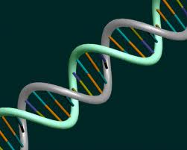
What is a DNA barcoding
DNA barcoding is a taxonomic method that uses a short genetic marker in an organism's DNA to identify it as belonging to a particular species. It differs from molecular phylogeny in that the main goal is not to determine patterns of relationship but to identify an unknown sample in terms of a preexisting classification.

Slide 19
DNA Barcoding
The sequence of certain chloroplast or nuclear
regions is the molecular identity of the species

Slide 20
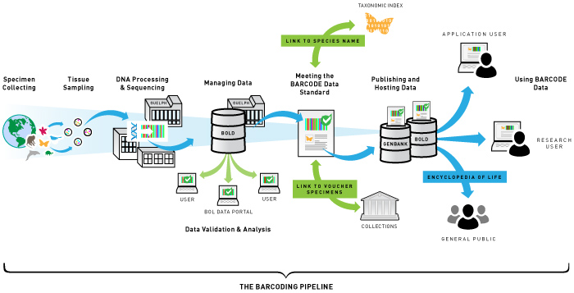
DNA barcoding ;
In 2003, Paul Hebert, researcher at the University of Guelph in Ontario, Canada, proposed “DNA barcoding” as a way to identify species. Barcoding uses a very short genetic sequence from a standard part of the genome the way a supermarket scanner distinguishes products using the black stripes of the Universal Product Code (UPC). Two items may look very similar to the untrained eye, but in both cases the barcodes are distinct.
http://www.barcodeoflife.org/content/about/what-dna-barcoding

Slide 21
Chloroplast genome
155.943 bp
Substitution rate is 0.2-1 x 10⁻⁹
Nucleus 5-30 x 10⁻⁹
1:3:12 mitochondrion : chloroplast: nucleus
Sugiura et. al. 1986, 2005
Notes:
Small compact circular genome 50-290kbp remarkably similar across the algal and plant lineages with regard to the complement of genes encoded within it their relative order and their sequence
Completely characterised – easy to manipulate
100 genes coding for photosynthetic proteins or components of expression apparatus such as ribosomal proteins
Plastids contain own expression system, ribosomes and polymerases-very active
Uses standard genetic code
genetic system 27.9 GC
Photosynthetic system 30.9 GC
where they observed that the synonymous rate of evolution of the mitochondrial, chloroplast and nuclear genes of angiosperms had ratios of 1:3:12. That is, the synonymous substitution rate of chloroplast genes of angiosperms species is three times higher than that of their mitochondrial genes and that of their nuclear genes nuclear genes are 12 times higher than that of their mitochondrial genes

Slide 22

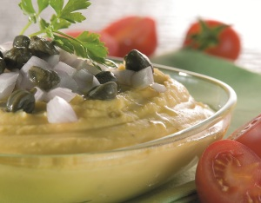
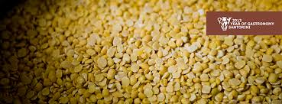
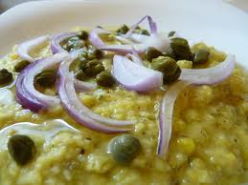

Fava Santorinis

Slide 23
Fava Santorinis
Other “Fava” species

Slide 24
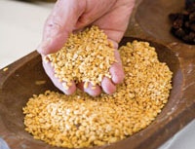
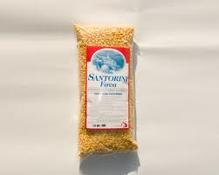
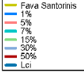

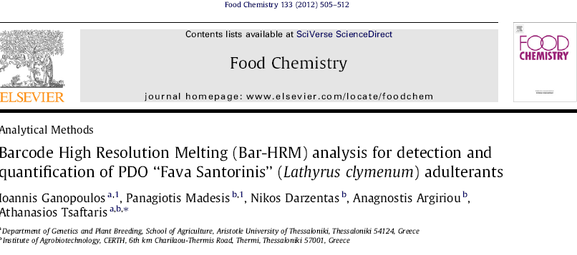
Fava Santorinis

Slide 25
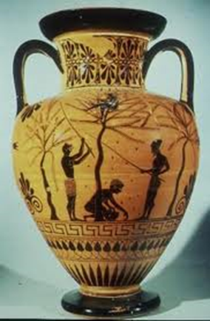
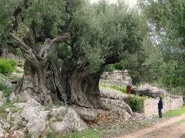

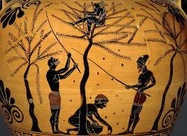
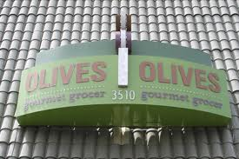
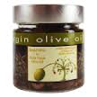
Olive varieties

Slide 26
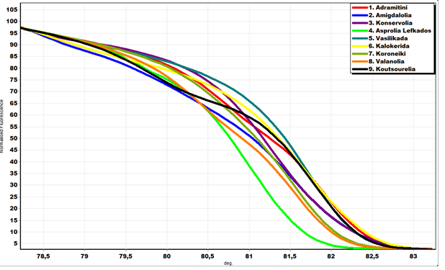
Olive varieties

Slide 27
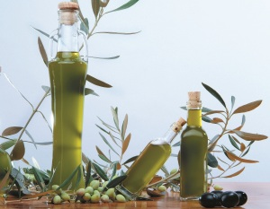
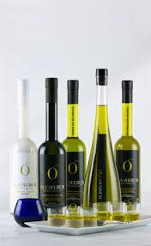
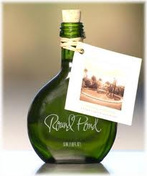
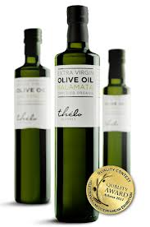
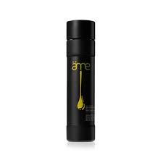

Olive oil

Slide 28


Oil authentication
Olive oil

Slide 29



Medicinal Plants Sideritis species “tsai tou vounou - Mountain Tea”
ITS2
Madesis et al 2014 in Press

Slide 30










Mediterranean Pine species

Slide 31

Greek indigenous varieties

Slide 32

Greek vine varieties
Greece has 64 varieties registered in the national catalogue
There are more non registered
More than 300 indigenous Greek Varieties
They are of Unknown genetic background and genetic relationship amongst them
Many are endangered

Slide 33

Greek endangered varieties
White Red

Slide 34

Utilization of indigenous varieties
Immediate Use Use of Local Varieties
Supported traditional agriculture and low-input cultivation system (fertilizers and pesticides)
They are suitable for cultivation in conditions of sustainable agriculture
They can be used for production of local branded products with added value

Slide 35


Farmer plays an important role
Farmers play an important role in conserving the local varieties
Protector of genetic diversity
The first "curator" of seeds (curator)
Increased genetic flow through the exchange of genetic material
Adapted cultivation practices
Maintained knowledge of uses playing a critical role in documentation recognition of varieties

Slide 36

Germplasm Conservation
The Germplasm has to be maintained in such a state that there is minimum risk for its loss and that either it can be planted directly in the field or it can be prepared for planted for planting with relative ease.
Ex-situ Conservation - Germplasm conservation is attempted outside or away from its natural habitat.
In-situ Conservation – Conservation of germplasm in its natural habitat or in area where it grows naturally.
On-farm Conservation One of new approach to in situ conservation of genetic resources, focusing on conserving cultivated plant species in farmers' fields. Its nothing but “The sustainable management of genetic diversity of locally developed traditional crop varieties, with associated wild and weedy species or forms, by farmers within traditional agricultural, horticultural or agri-silvicultural cultivation systems"

Slide 37



Slide 38



